Slide 1
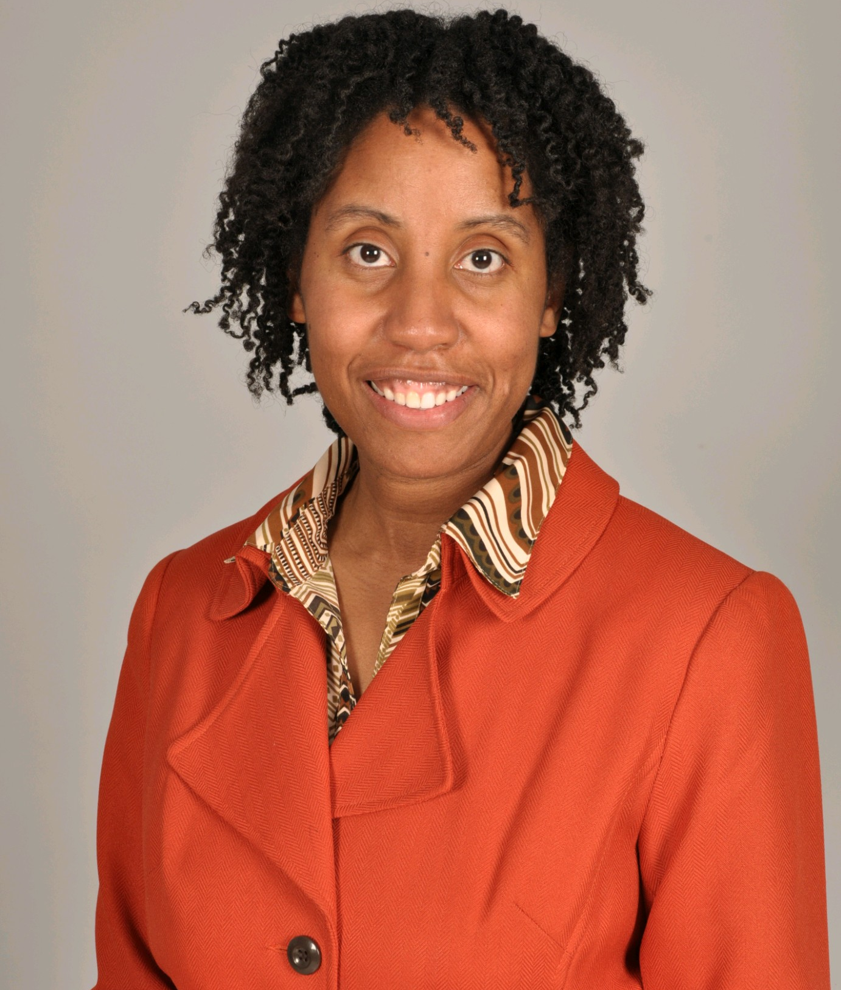
Sharon Inkster Church Education Department
Guest Speaker -
Dr, Sandia Waller, PhD. RDN. LMT Doctor of Nutrition, Dietician, Massage Therapist
Doctor of Nutrition, DietitiaTherapist.
Sunday, April 24, 2022
12 noon ET
Theme: The Resurrection Story
Recitations by students from Sharon SDA Church, Peterson-Warren Academy and other schools in Michigan, Texas and Alabama
“I Am So Glad that Jesus Loves Me”
Violin Solo
Quiz
Topic: “Jesus & New Beginnings - Tips for Students”

Slide 2
Program, pt 1
Opening Prayer – Barbara Patterson, Para-Pro, Decatur City Schools, AL
Scripture – Alanna Patterson, Kindergarten
Welcome – J. Blake, Education Leader, Sharon SDA Church
Opening Song – “I Am So Glad that Jesus Loves Me”
Easter Poem – Nyami Jemison, gr. 3
Scripture – Matt 1:21 – Shamael St. Louis, gr 6
The Lord’s Prayer Song – St. Louis Children, Adael – gr 4, Phatael–gr 3, Elshamai – K, Shamael – gr 6
Resurrection Poem – Mek’hai Brown, gr. 3

Slide 3
Program, pt. 2
9. Song –”God’s Not Dead” – Jackson Children: Bryannah & Joseph, gr. 2
Brielle, gr. 1
10. Prayer for Students – Pastor Keynel Cadet, Sharon SDA Church
11. Violin Solo – “Jesus Loves Me”
12. Guest Speaker – Dr. Sandia Waller, PhD., RDN, LMT
13. Scripture – Moses Jemison, gr. 4
14. Quiz
15. Closing Prayer – Sharon Smith, retired teacher, PWA

Slide 4
Join us in May.
Read More!
Aim High!

