Slide 1
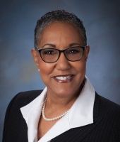
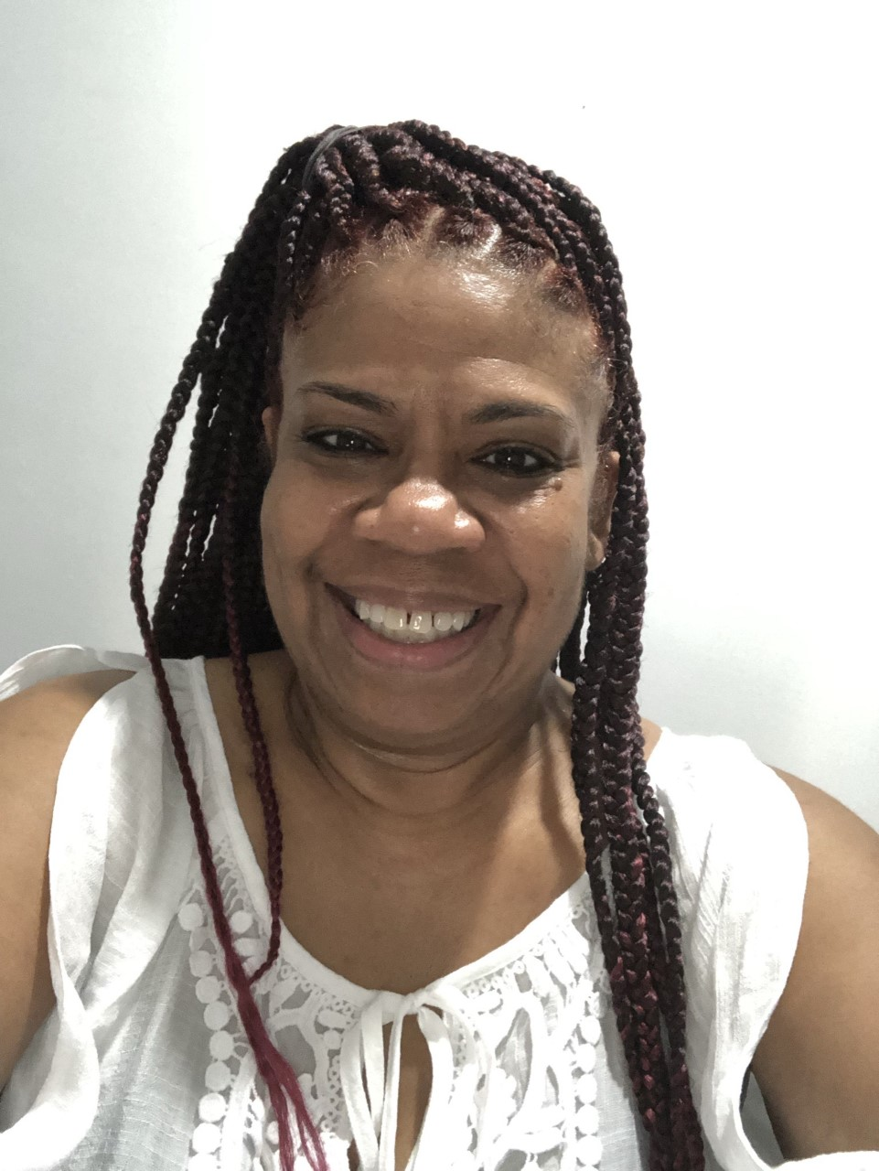
Sharon Inkster Church Education Department
Guest Speaker -
Renee Kimmey Anderson, MAT, Ed.S. Special Ed Teacher, Newton Cty Schools, Georgia
Sunday, March 27, 2022
12 Noon ET
March is Reading Month – Presentations by students from Sharon SDA Church, Peterson-Warren Academy and schools in Michigan, California and Kentucky.
“Give Me The Bible”
“Parts of a Book Song”
Quiz
Topic: “How to Choose a
Good Fit Book”

