Slide 1
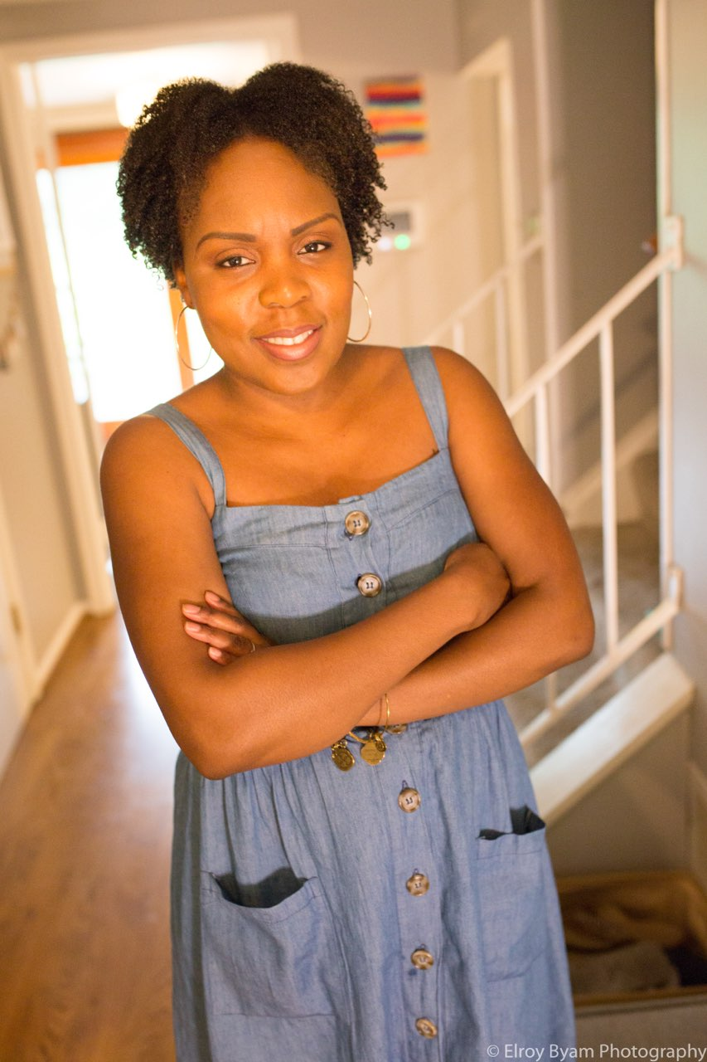
Sharon Inkster Church Education Department
Guest Speaker -
Toula Adu, M.S., CCC-SLP
Pediatric Speech Language Pathologist
Owner – Bizzy Bee Organizing
Doctor of Nutrition, DietitiaTherapist.
Sunday, May 22, 2022
12 noon ET
Theme: Mother’s Day
Recitations by students from Sharon SDA Church, Peterson-Warren Academy and other schools in California and Alabama
Mother’s Day Song
College Graduate Speaks – T. Eldridge
Quiz
Topic: ”Mothers Organizing the Home for Student Success”

